Slide 1

TRAVEL RECOMMENDATION SYSTEM

Slide 2
CONTENTS
INRODUCTION
ABSTRACT
LIBRARIES USED
CONTENT BASED FILTERING
ADVANTAGES OF CB
COLLOBORATIVE FILTERING
HYBRID BASED FILTERING
RESULT
FUTURE WORK
CONCLUSIONS

Slide 3

INTRODUCTION
Travel recommendation methods are essential for enhancing user experiences. They encompass content-based recommendation, collaborative filtering, and hybrid approaches, shaping user satisfaction and engagement

Slide 4
ABSTRACT
Tourism plays a pivotal role in bolstering a nation's economic landscape. However, despite its significance, there remains a conspicuous absence of a comprehensive platform catering to the personalized needs of tourists seeking information on attractions.
The establishment of a system adept at furnishing tailored and precise insights into local attractions, culinary delights, and shopping avenues stands poised to revolutionize the tourist experience.
In determining item similarities, the cosine similarity method is employed, facilitating a nuanced understanding of user preferences.

Slide 5
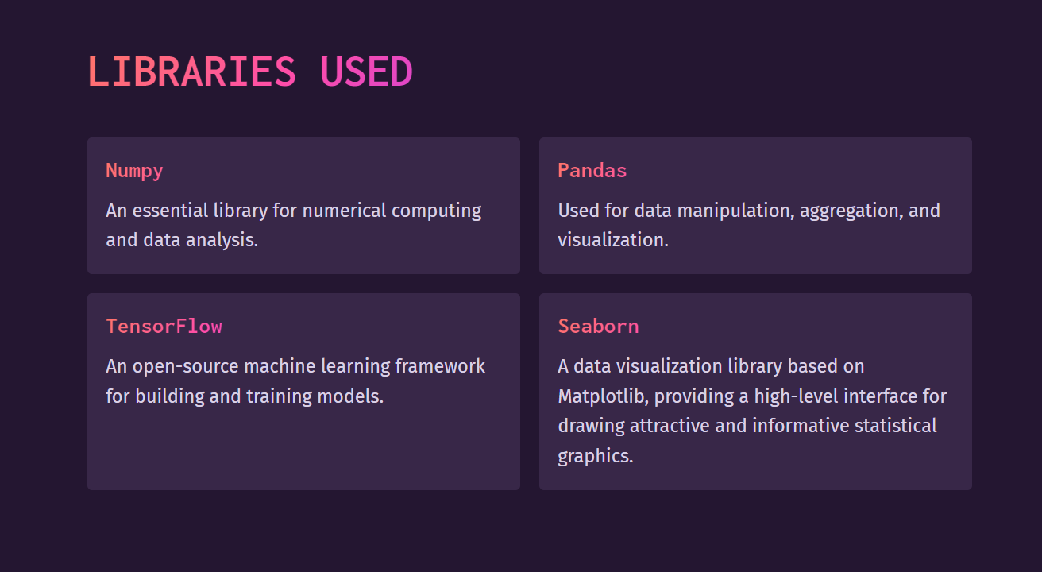

Slide 6

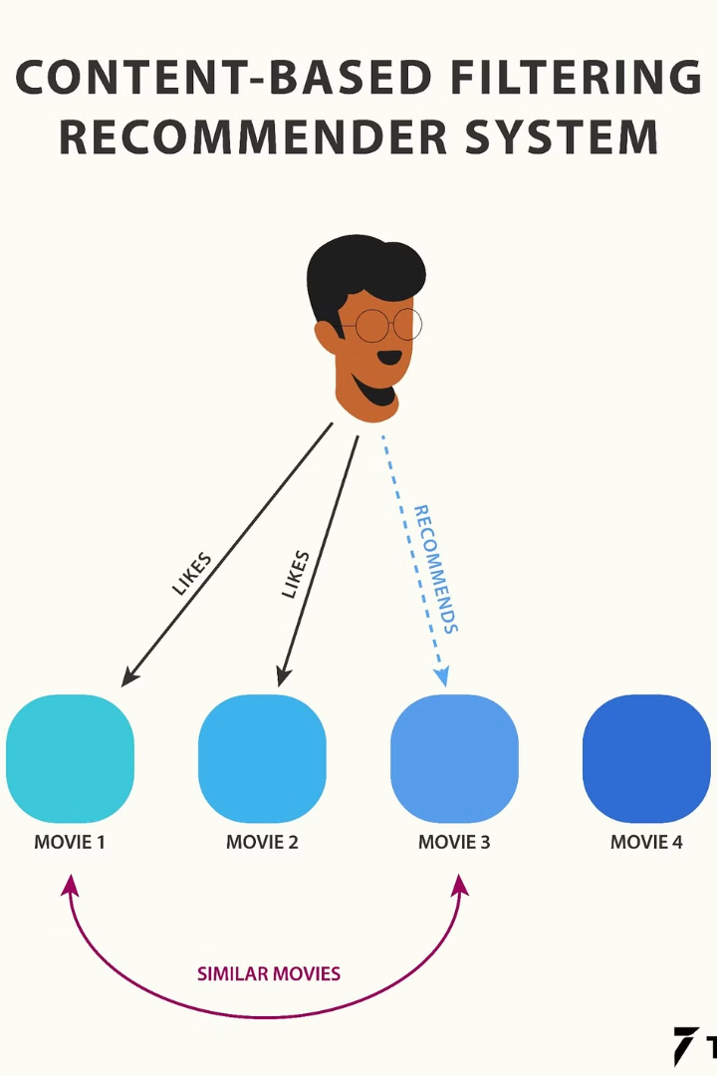
Content-Based Filtering
Content-based filtering is a recommendation approach that analyzes the characteristics and attributes of items to suggest new items that are similar to ones a user has liked in the past. It focuses on the intrinsic properties of the items rather than user preferences or behaviors.
This technique is particularly useful for recommending niche or obscure items that may not have many user interactions, as it can identify relevant content based on textual metadata, multimedia features, and other contextual information.

Slide 7



Advantages of Content-Based Recommendation
Personalized Travel Recommendations
Independence from Others
Reduced Cold Start Problem
Content-based recommendation approach tailors suggestions based on the user's preferences and interests, providing a bright and cheerful mood for travel planning.
This approach focuses solely on the individual user's choices and preferences in a clear and well-lit environment, emphasizing independent decision-making.
Content-based recommendation provides personalized suggestions for new or niche items, creating a vibrant and inviting atmosphere with soft ambient lighting, reducing the cold start problem.

Slide 8




Collaborative Filtering Approach
Data Collection
Aggregating user preferences and interactions with similar travelers.
Pattern Recognition
Identifying common preferences and connections among like-minded travelers.
Personalized Recommendations
Offering tailored travel suggestions based on compatibility with similar users.

Slide 9
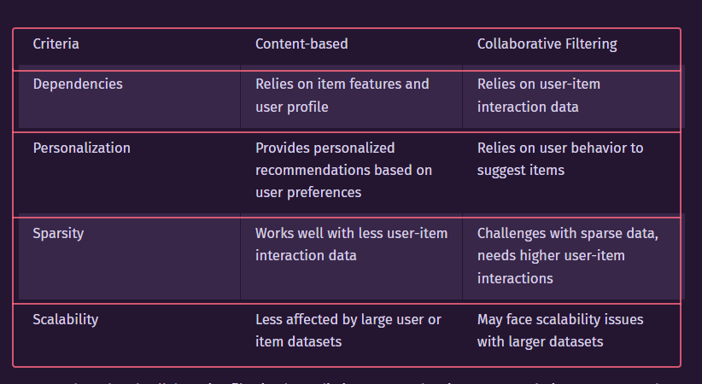

Slide 10
Limitations of Collaborative Filtering
Data Sparsity
Cold Start Problem
Scalability
Privacy Concerns
Collaborative filtering struggles with sparse data, making it ineffective when there are insufficient user-item interactions.
As the number of users and items increases, the computational complexity also grows, impacting real-time recommendation.
Collaborative filtering relies on user data, raising privacy issues and trust issues in some contexts.
It faces challenges in recommending items for new users or items with limited historical data.

Slide 11



Hybrid recommendation approach
Utilizes both content-based and collaborative filtering
1
Combining the strengths of both methods for improved recommendations
Enhances personalization
2
Provides more personalized and accurate travel suggestions
Addresses cold start problem
3
Effective for new or niche content with limited user interactions

Slide 12
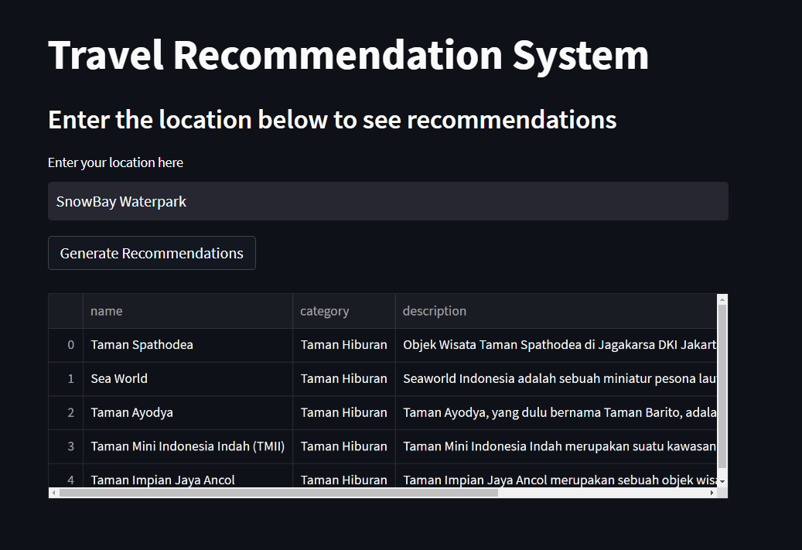
RESULT

Slide 13
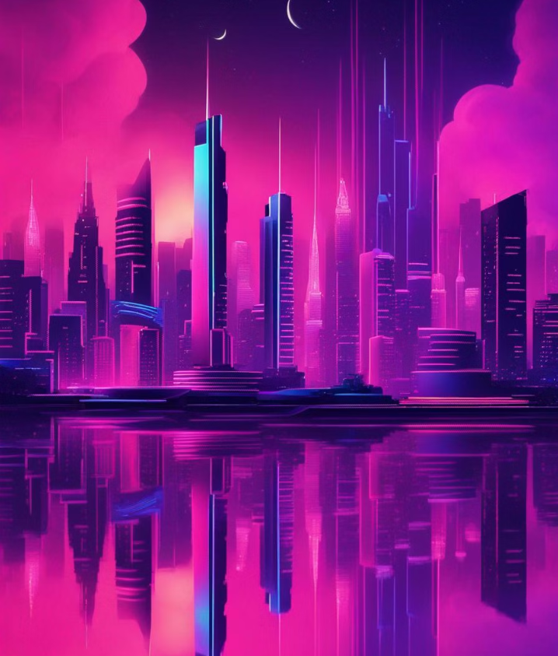
FUTURE WORK
Exploring advancements in AI for personalized travel recommendations.
Implementing real-time user feedback for dynamic destination suggestions.
Enhancing user experience with virtual reality for pre-travel explorations.

Slide 14

Conclusion
As we conclude our exploration of travel recommendation methods, it's evident that hybrid approaches hold significant promise for personalized and effective recommendations. The fusion of content-based and collaborative filtering methods is likely to lead the way in enhancing user experiences and satisfaction in the future of travel recommendation systems.

Slide 15
SUBMITTED BY
P.VENKATA MOHAN
B.BHAVYA
P.JASWANTH

